Slide 1
Chapter 9 Phase Diagrams
Definitions and basic concepts
Phases and microstructure
Binary isomorphous systems (complete solid solubility)
Binary eutectic systems (limited solid solubility)
Binary systems with intermediate phases/compounds
The iron-carbon system (steel and cast iron)

Slide 2
Components and Phases
Component - chemical species
(Fe + C in steel; H₂O + NaCl in salt water).
Binary alloy →2 two components,
Ternary alloy – 3, etc.
Phase – a portion that has uniform physical and chemical characteristics
Two phases in a system have distinct physical or chemical characteristics
(e.g. water and ice)
Separated by a phase boundary

Slide 3
A phase may contain one or more components.
A single-phase system = Homogeneous.
System with two or more phases
= mixture or heterogeneous system.

Slide 4
Solubility Limit
Solvent - host or major component
Solute - minor component
Solubility Limit = maximum amount that can be dissolved in a phase
(e.g. alcohol has unlimited solubility in water, sugar has a limited solubility, oil is insoluble).

Slide 5
Same concepts for solid phases: Cu and Ni are mutually soluble in any amount (unlimited solid solubility), while C has a limited solubility in Fe.

Slide 6
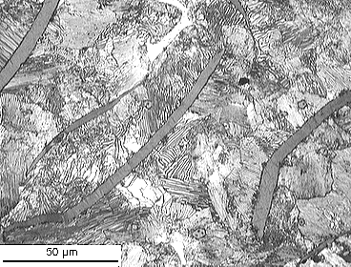
Microstructure
Properties of alloy depend on proportions of the phases and on how they are arranged at the microscopic level.
Microstructure given by number of phases, their proportions, and their arrangement in space.
Alloy of Fe with 4 wt.% C. There are several phases. The long gray regions are flakes of graphite. The matrix is a fine mixture of BCC Fe and Fe₃C compound.
Phase diagrams help understand and predict microstructures
Microstructure of cast Iron

Slide 7
Equilibrium and Metastable States
Equilibrium: at constant temperature, pressure and composition system is stable
(Equilibrium is achieved given sufficient time, but that may be very long. )
Metastable: System appears to be stable
In thermodynamics: equilibrium is state corresponds to the minimum of the free energy.

Slide 8
Under conditions of constant temperature, pressure and composition, change is toward lower free energy.
Stable equilibrium is state with minimum free energy.
Metastable state is a local minimum of free energy.
equilibrium
Free Energy
metastable

Slide 9
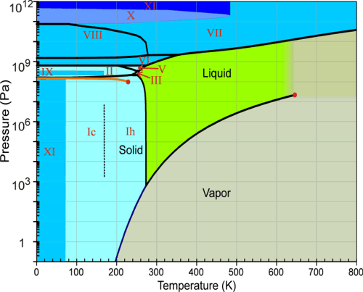
Phase diagram
Phase diagram - graphical representation of the combinations of temperature, pressure or composition for which specific phases exist at equilibrium.
H₂O: diagram shows temperature and pressure at which ice (solid),water (liquid) and steam (gas) exist.

Slide 10
Phase diagrams show what phases exist at equilibrium and what transformations we can expect when we change one parameter (T, P, composition).
Will discuss phase diagrams for binary alloys only
Will assume pressure to be constant at one atmosphere.

Slide 11
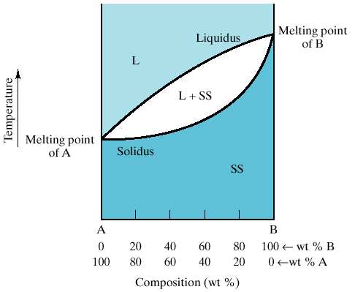
Binary Isomorphous System
Complete solubility of the two components
(both in the liquid and solid phases).
Three phase regions :
Liquid (L) , solid + liquid (α +L), solid (α )
Liquidus line separates liquid from liquid + solid
Solidus line separates solid from liquid + solid
L
α + L
α

Slide 12
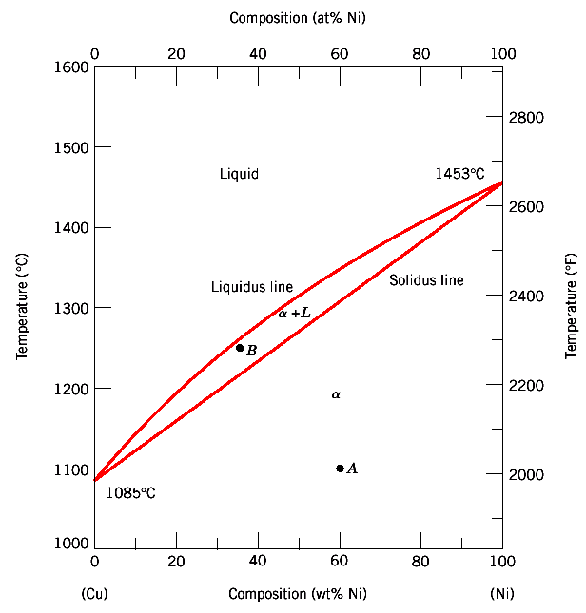
Binary Isomorphous Systems
Example: Cu-Ni
Complete solubility occurs because Cu and Ni have the same crystal structure (FCC), similar radii, electronegativity and valence

Slide 13
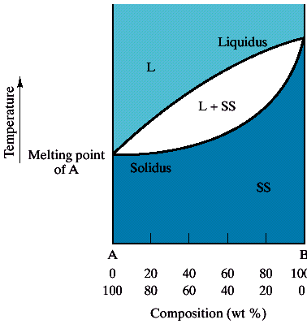


One-component: melting occurs at a well-defined temperature.
Multi-component: melting occurs over range of temperatures between
solidus and liquidus lines.
Solid and liquid phases are in equilibrium in this temperature range.
L
Liquid solution
α + L
Liquid solution
+
Crystallites of
Solid solution
α
Polycrystal
Solid solution

Slide 14
Interpretation of Phase Diagrams
For given temperature and composition can determine:
1) Phases present
2) Compositions of phases
3) Relative fractions of phases

Slide 15
Finding the composition in a two phase region:
1. Locate composition and temperature
2. In two phase region draw tie line or isotherm
Note intersection with phase boundaries.
Read compositions at the intersections.
Liquid and solid phases have these compositions.

Slide 16
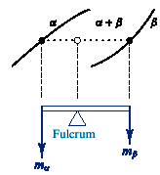
The Lever Rule
Find amounts of phases in two phase region
Locate composition and temperature
Draw tie line or isotherm
Fraction of a phase = length of tie line to other phase boundary divided by the length of tie line
The lever rule is a mechanical analogy to the mass balance calculation. The tie line in the two-phase region is analogous to a lever balanced on a fulcrum.

Slide 17
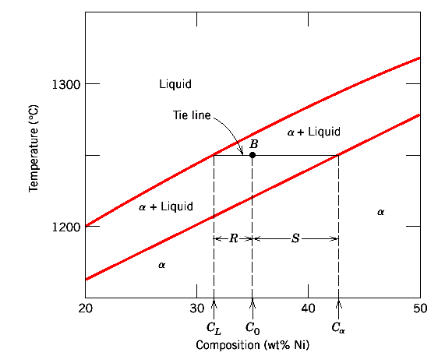
The Lever Rule
Mass fractions: W_{L} = S / (R+S) = (C_{α} - C_{o}) / (C_{α} - C_{L})
W_{α} = R / (R+S) = (C_{o} - C_{L}) / (C_{α} - C_{L})

Slide 18
Derivation of the lever rule
W_{α} and W_{L} are fractions of α and L phases
1) All material is in one phase or the other:
W_{α} + W_{L} = 1
2) Composition equal composition in one phase + composition second phase
at given T:
C_{o} = W_{α}C_{α} + W_{L}C_{L}
3) Solution gives Lever rule.
W_{L} = (C_{α} - C_{o}) / (C_{α} - C_{L})
W_{α} = (C_{o} - C_{L}) / (C_{α} - C_{L})

Slide 19
Phase compositions and amounts. An example.
C_{o} = 35 wt. %, C_{L} = 31.5 wt. %, C_{α} = 42.5 wt. %
Mass fractions: W_{L} = (C_{α} - C_{o}) / (C_{α} - C_{L}) = 0.68
W_{α} = (C_{o} - C_{L}) / (C_{α} - C_{L}) = 0.32

Slide 20
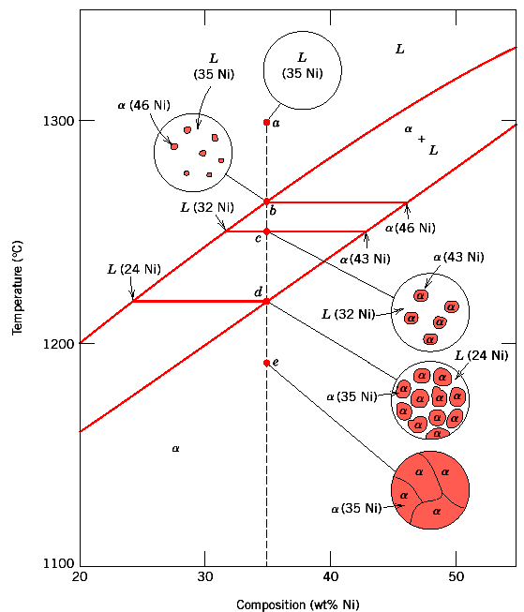
Microstructure in isomorphous alloys
Equilibrium (very slow) cooling

Slide 21
Development of microstructure
in isomorphous alloys
Equilibrium (very slow) cooling
Upon cooling from the liquidus line (in the solid + liquid phase region) formation of the solid occurs gradually.
Compositions of the solid and the liquid change gradually during cooling
(as determined by the tie-line method.)
At the solidus line, nuclei grow to consume all the liquid

Slide 22
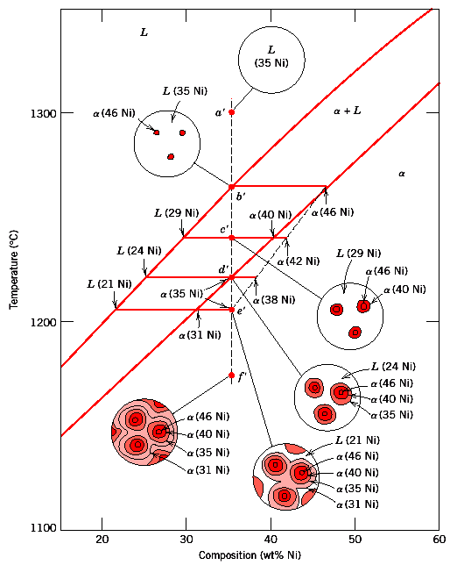
Non-equilibrium cooling

Slide 23
Compositional change → diffusion
  SOLID
Diffusion is very slow ⇒ Tie-line invalid
New layers formed on top of existing grains have the equilibrium composition at that T ⇒ Formation of layered (cored) grains.
LIQUID
Diffusion is fast → Tie-line method works
Lever rule ⇒ greater proportion of liquid phase as compared to equilibrium at the same T ⇒ Solidus line is shifted to the right (higher Ni content), solidification is complete at lower T, outer parts of grains are richer in the low-melting component (Cu).
Upon heating grain boundaries will melt first. This can lead to premature mechanical failure.

Slide 24
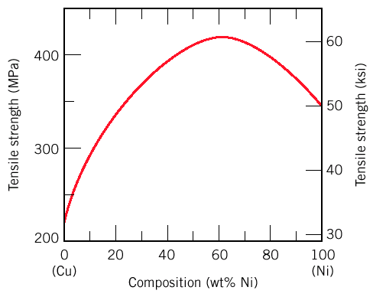
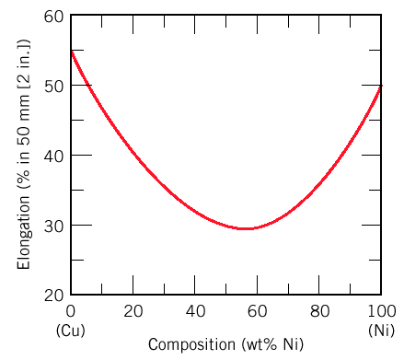
Mechanical properties of isomorphous alloys
Solid solution strengthening

Slide 25
Binary Eutectic Systems
alloys with limited solubility
silver (Ag) / copper (Cu)
radii differ
The melting point of eutectic alloy
is lower than that of the components
(eutectic = easy to melt in Greek).

Slide 26
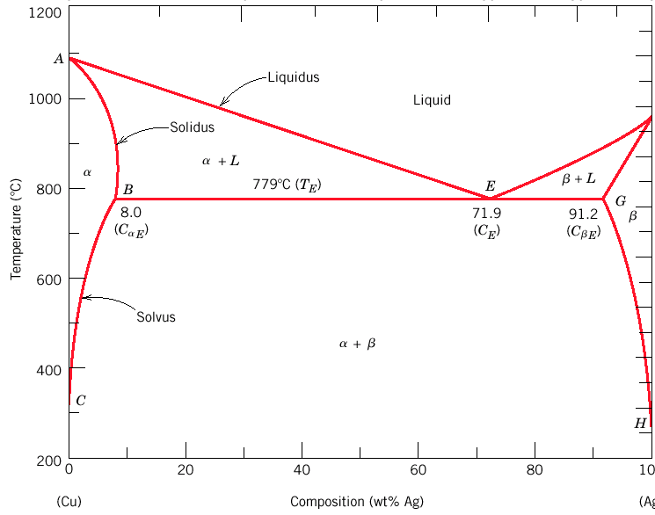
Binary Eutectic System
Copper – Silver phase diagram
Three single phase regions
α = solid solution Ag in Cu matrix,
β = solid solution of Cu in Ag matrix,
L = liquid
Three two-phase regions (α + L, β +L, α +β)
Solvus ⇒ limit of solubility
Separates one solid solution from the mixture

Slide 27
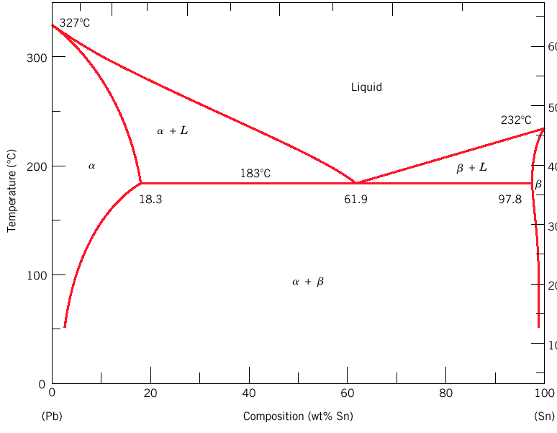
Binary Eutectic System
Lead – Tin phase diagram
Invariant or eutectic point
Eutectic isotherm
Eutectic or invariant point - Liquid + two solid phases co-exist at eutectic composition C_{E} and eutectic temperature T_{E}
Eutectic isotherm - horizontal solidus line at T_{E}

Slide 28
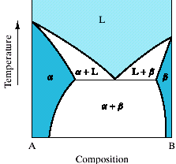
Binary Eutectic System
Eutectic reaction – transition from liquid to mixture of two solid phases, α + β at eutectic concentration C_{E}.
Two phases in equilibrium except:
Three phases (L, α, β) in equilibrium only at a few points along the eutectic isotherm. Single-phase regions are separated by 2-phase regions.

Slide 29
Compositions and relative amounts of phases are determined from the same tie lines and lever rule, as for isomorphous alloys--demonstrate
• A
• B
• C

Slide 30
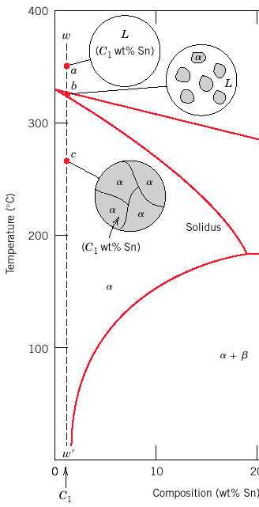
Microstructure in eutectic alloys
Several types of microstructure formed in slow cooling an different compositions.
Cooling of liquid lead/tin system at different compositions.
In this case of lead-rich alloy (0-2 wt. % of tin) solidification proceeds in the same manner as for isomorphous alloys (e.g. Cu-Ni) that we discussed earlier.
L → α +L→ α

Slide 31
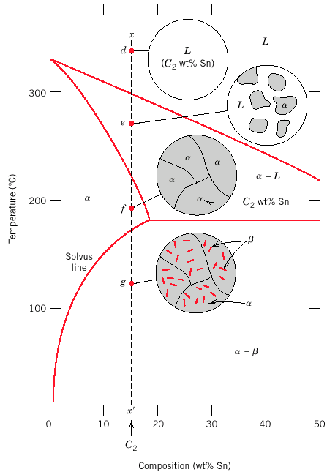
Microstructure in eutectic alloys
At compositions between room temperature solubility limit and the maximum solid solubility at the eutectic temperature, β phase nucleates as the α solid solubility is exceeded at solvus line.
L
α +L
α
α +β

Slide 32
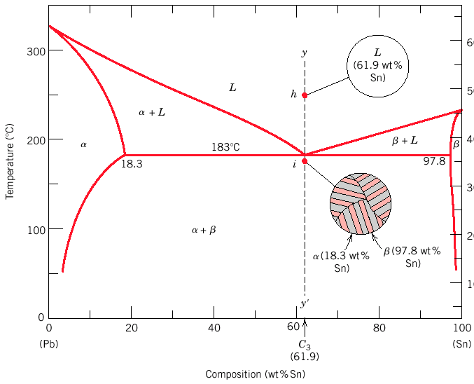
Solidification at the eutectic composition
No changes above eutectic temperature, T_{E}. At T_{E} liquid transforms to α and β phases (eutectic reaction).
L → α +β

Slide 33

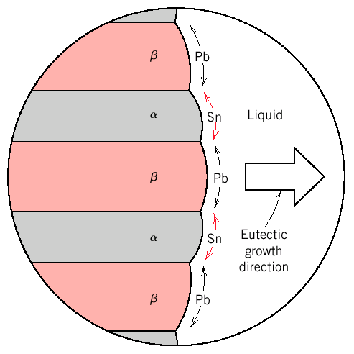
Compositions of α and β very different → eutectic reaction involves redistribution of Pb and Sn atoms by atomic diffusion. Simultaneous formation of α and β phases results in a layered (lamellar) microstructure:called eutectic structure.
Formation of eutectic structure in lead-tin system.
Dark layers are lead-rich α phase.
Light layers are the tin-rich β phase.

Slide 34
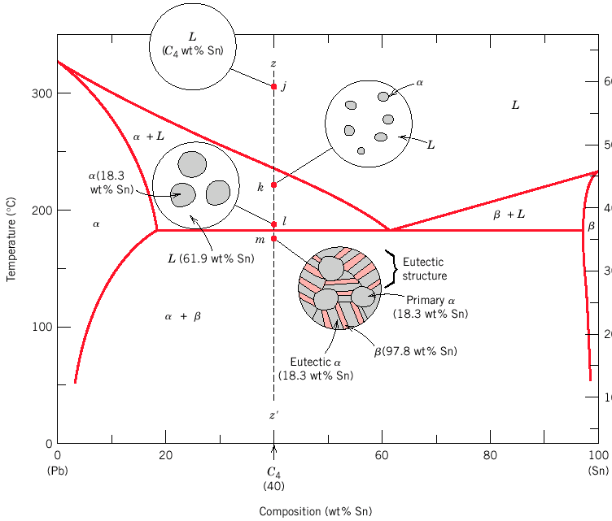
Primary α phase is formed in the α + L region, and the eutectic structure that includes layers of α and β phases (called eutectic α and eutectic β phases) is formed upon crossing the eutectic isotherm.
L → α + L → α +β

Slide 35
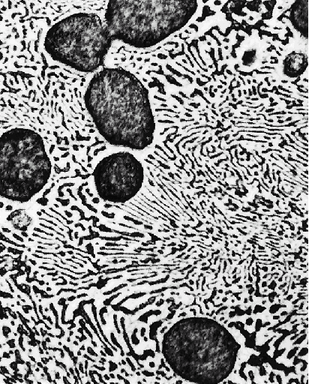
Microconstituent – element of microstructure having a distinctive structure. For case described on previous page, microstructure consists of two microconstituents, primary α phase and the eutectic structure.
Although the eutectic structure consists of two phases, it is a microconstituent with distinct lamellar structure and fixed ratio of the two phases.

Slide 36
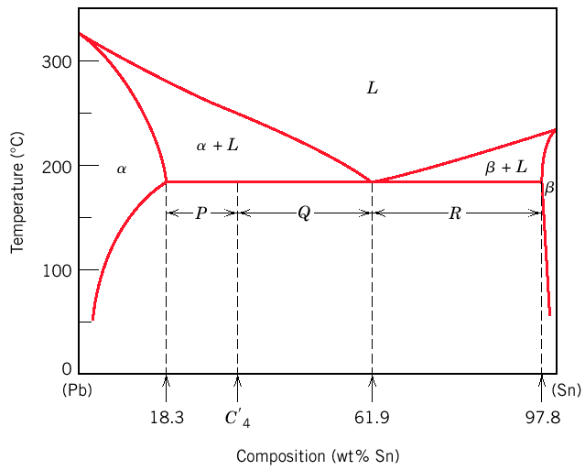
Relative amounts of microconstituents?
Eutectic microconstituent forms from liquid having eutectic composition (61.9 wt% Sn)
Treat eutectic as separate phase and apply lever rule to find relative fractions of primary α phase (18.3 wt% Sn) and eutectic structure (61.9 wt% Sn):
W_{e} = P / (P+Q) (eutectic) W_{α’} = Q / (P+Q) (primary)

Slide 37
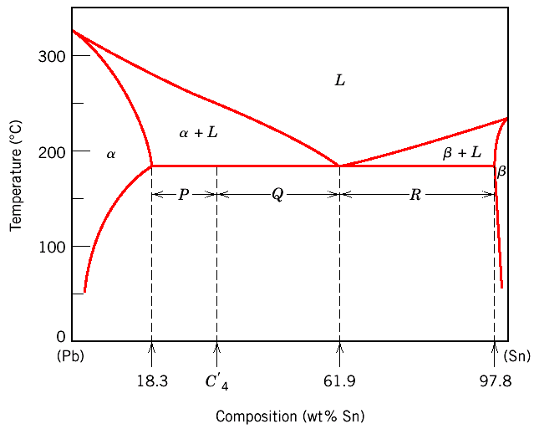
How to calculate the total amount of α phase (both eutectic and primary)?
Fraction of α phase determined by application of the lever rule across the entire α + β phase field:
W_{α} = (Q+R) / (P+Q+R) (α phase)
W_{β} = P / (P+Q+R) (β phase)

Slide 38
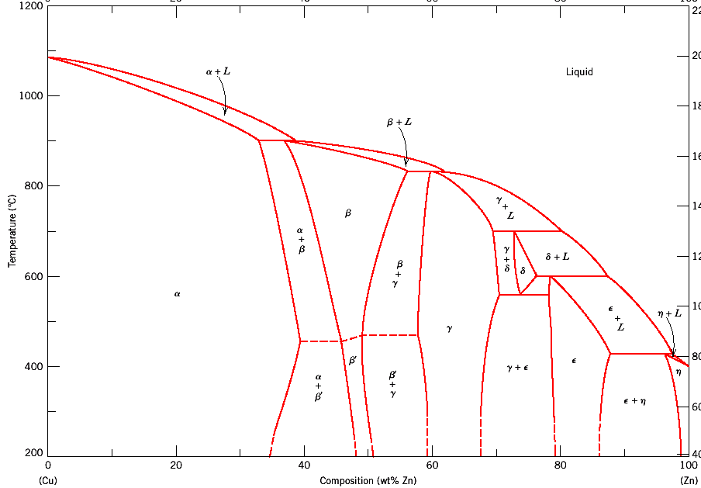
Intermediate Phases
So far only two solid phases (α and β)
Terminal solid solutions
Some binary systems have intermediate
solid solution phases.
Cu-Zn: α and η are terminal solid solutions,
β, β’, γ, δ, ε are intermediate solid solutions.

Slide 39
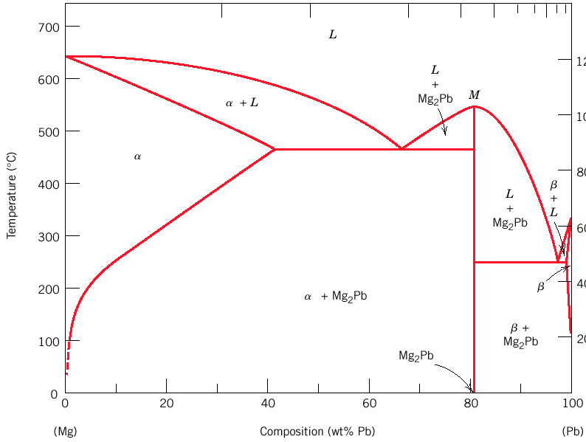
Intermetallic Compounds
Intermetallic compounds →
precise chemical compositions exist in some systems.
Using the lever rules, intermetallic compounds are treated like any other phase,
They appear as a vertical line.
Two eutectic diagrams: Mg-Mg₂Pb and Mg₂Pb-Pb. Intermetallic compound Mg₂Pb is considered a component.
intermetallic
compound

Slide 40
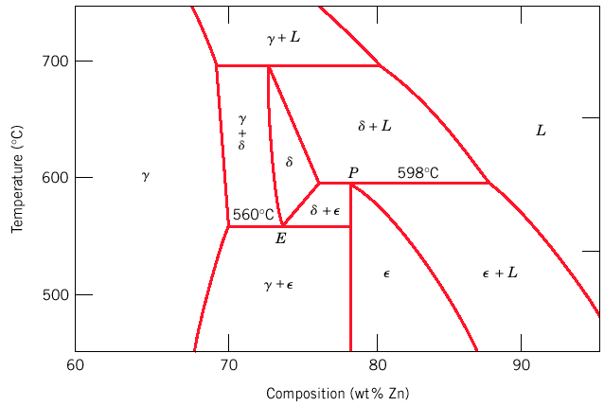
Eutectoid Reactions
Eutectoid (eutectic-like in Greek) reaction similar to eutectic reaction
One solid phase to two new solid phases
Invariant point (the eutectoid) → Three solid phases in equilibrium
Upon cooling, a solid phase transforms into two other solid phases (δ ↔ γ + ε below)
Cu-Zn
Eutectoid

Slide 41
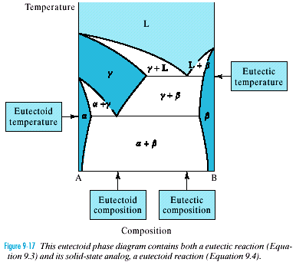
Eutectoid Reactions
Contains an eutectic reaction
and an eutectoid reaction

Slide 42
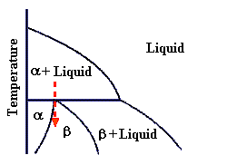
Peritectic Reactions
Peritectic → solid phase + liquid phase will together form a second solid phase at a particular temperature and composition upon cooling
L + α ↔ β
Peritectics are not as common as eutectics and eutectiods. There is one in Fe-C system

Slide 43
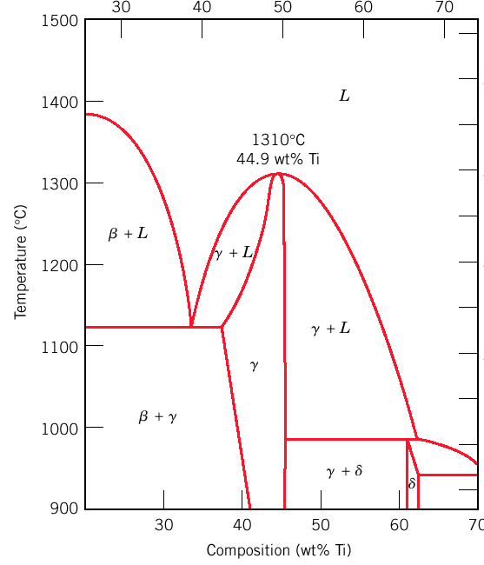
Congruent Phase Transformations
Congruent transformation → no change in composition
(e.g, allotropic transformation such as α-Fe to γ-Fe or melting transitions in pure solids)
Incongruent transformation, at least one phase changes composition (eutectic, eutectoid, peritectic).
Congruent
melting of γ
Ni-Ti

Slide 44
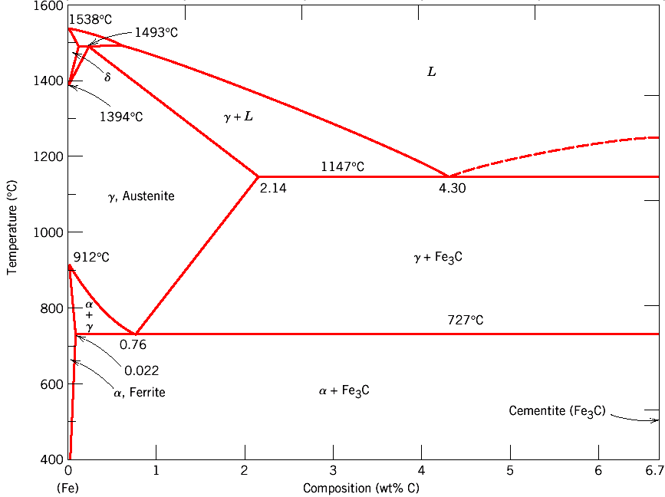
The Iron–Iron Carbide (Fe–Fe₃C) Phase Diagram
Steels: alloys of Iron (Fe) and Carbon (C).
Fe-C phase diagram is complex. Will only consider the steel part of the diagram, up to around 7% Carbon.

Slide 45
Phases in Fe–Fe₃C Phase Diagram
α-ferrite - solid solution of C in BCC Fe
  Stable form of iron at room temperature.
  The maximum solubility of C is 0.022 wt%
  Transforms to FCC γ-austenite at 912 °C
γ-austenite - solid solution of C in FCC Fe
  The maximum solubility of C is 2.14 wt %.
  Transforms to BCC δ-ferrite at 1395 °C
  Is not stable below the eutectic temperature
  (727 ° C) unless cooled rapidly (Chapter 10)
δ-ferrite solid solution of C in BCC Fe
  The same structure as α-ferrite
  Stable only at high T, above 1394 °C
  Melts at 1538 °C
Fe₃C (iron carbide or cementite)
  This intermetallic compound is metastable, it remains as a compound indefinitely at room T, but decomposes (very slowly, within several years) into α-Fe and C (graphite) at 650 - 700 °C
Fe-C liquid solution

Slide 46
Comments on Fe–Fe₃C system
C is an interstitial impurity in Fe. It forms a solid solution with α, γ, δ phases of iron
Maximum solubility in BCC α-ferrite is 0.022 wt% at 727 °C. BCC:relatively small interstitial positions
Maximum solubility in FCC austenite is 2.14 wt% at 1147 °C - FCC has larger interstitial positions
Mechanical properties: Cementite (Fe₃C is hard and brittle: strengthens steels. Mechanical properties also depend on microstructure: how ferrite and cementite are mixed.
Magnetic properties: α -ferrite is magnetic below 768 °C, austenite is non-magnetic
Classification. Three types of ferrous alloys:
Iron: < 0.008 wt % C in α−ferrite at room T
Steels: 0.008 - 2.14 wt % C (usually < 1 wt % )
α-ferrite + Fe₃C at room T
Cast iron: 2.14 - 6.7 wt % (usually < 4.5 wt %)

Slide 47
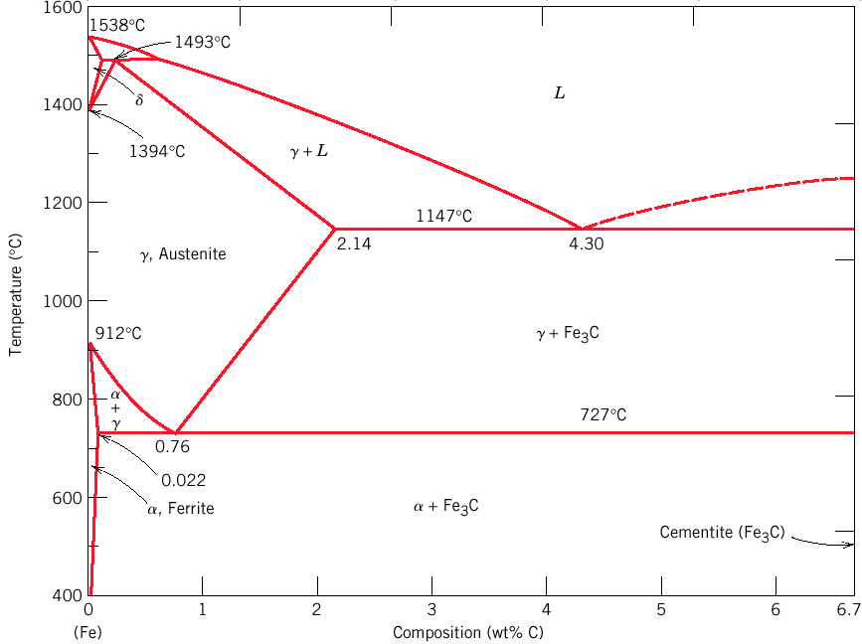
Eutectic and eutectoid reactions in Fe–Fe₃C
Eutectic: 4.30 wt% C, 1147 °C
L ↔ γ + Fe₃C
Eutectic and Eutectoid reactions are important in heat treatment of steels
Eutectoid: 0.76 wt%C, 727 °C
γ(0.76 wt% C) ↔ α (0.022 wt% C) + Fe₃C

Slide 48
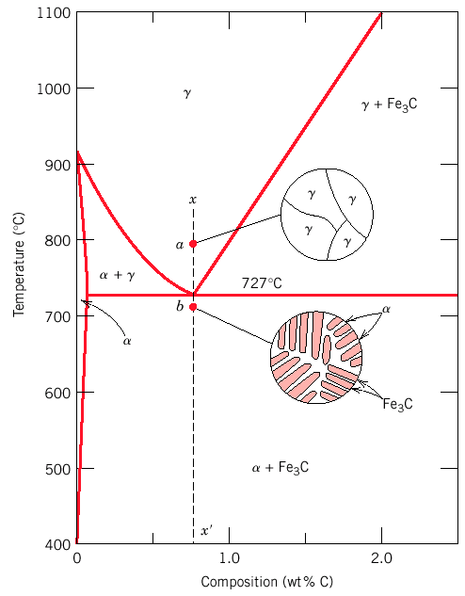
Microstructure in Iron - Carbon alloys
Microstructure depends on composition (carbon content) and heat treatment.
Assume slow cooling → equilibrium maintained
Microstructure of eutectoid steel

Slide 49
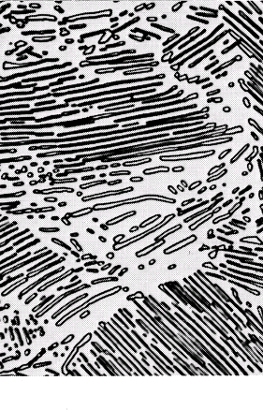
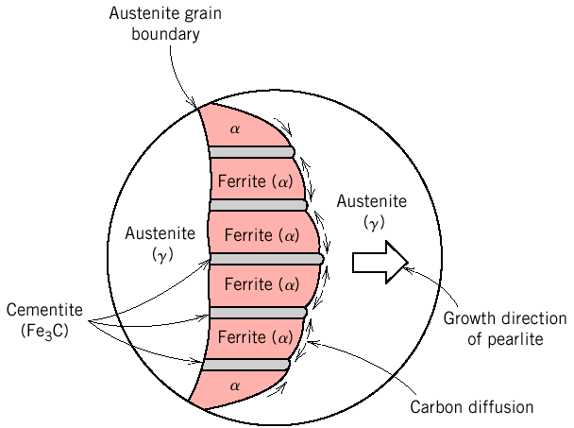
Microstructure of eutectoid steel
Pearlite, layered structure of two phases: α-ferrite and cementite (Fe₃C)
Alloy of eutectoid composition (0.76 wt % C) Layers formed for same reason as in eutectic: Atomic diffusion of C atoms between ferrite (0.022 wt%) and cementite (6.7 wt%)
Mechanically, properties intermediate to soft, ductile ferrite and hard, brittle cementite.
In the micrograph, the dark areas are Fe₃C layers, the light phase is α-ferrite

Slide 50
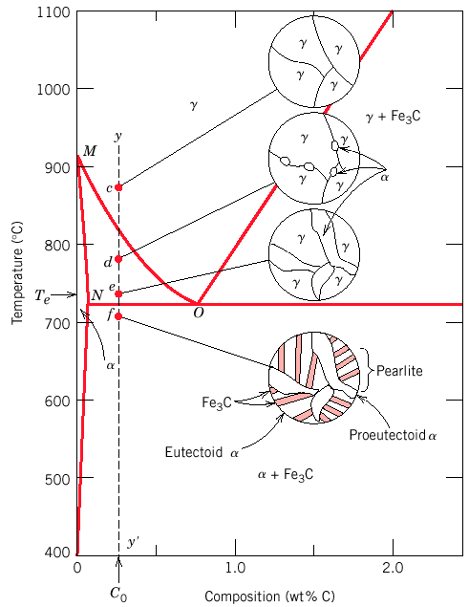
Microstructure of hypoeutectoid steel
Compositions to the left of eutectoid (0.022 - 0.76 wt % C) hypoeutectoid (less than eutectoid -Greek) alloys.
γ → α + γ → α + Fe₃C

Slide 51
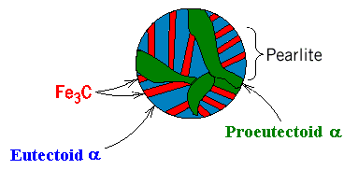
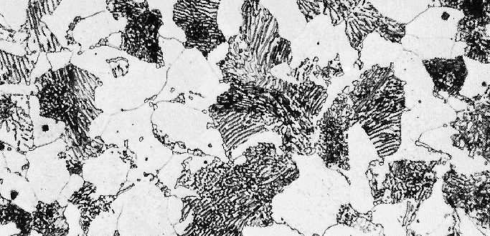
Microstructure of hypoeutectoid steel
Hypoeutectoid contains proeutectoid ferrite formed above eutectoid temperature and eutectoid perlite that contains ferrite and cementite.

Slide 52
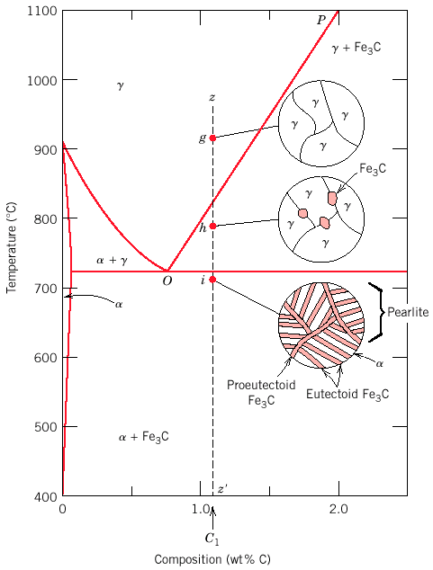
Microstructure of hypereutectoid steel
Compositions to right of eutectoid (0.76 - 2.14 wt % C) hypereutectoid (more than eutectoid -Greek) alloys. γ → γ + Fe₃C → α + Fe₃C

Slide 53
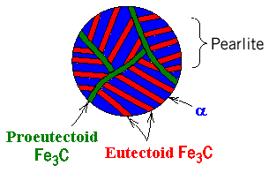
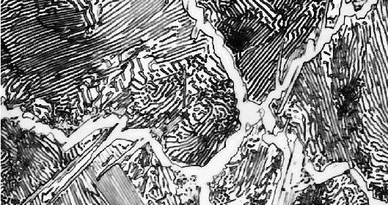
Microstructure of hypereutectoid steel
Hypereutectoid contains proeutectoid cementite (formed above eutectoid temperature) plus perlite that contains eutectoid ferrite and cementite.

Slide 54
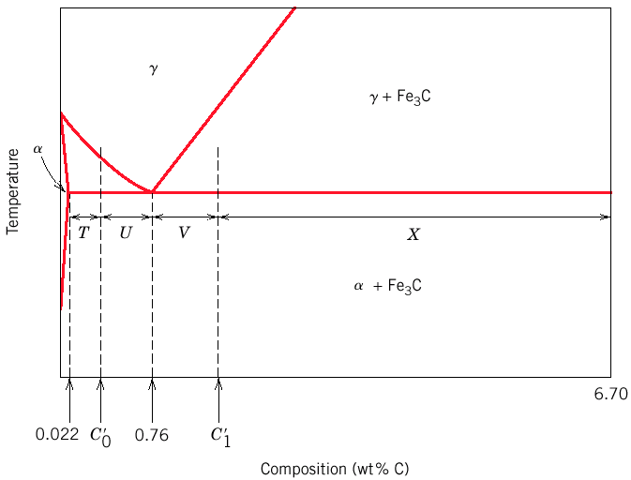
How to calculate the relative amounts of proeutectoid phase (α or Fe₃C) and pearlite?
Lever rule + tie line that extends from the eutectoid composition (0.75 wt% C) to α – (α + Fe₃C) boundary (0.022 wt% C) for hypoeutectoid alloys and to (α + Fe₃C) – Fe₃C boundary (6.7 wt% C) for hypereutectoid alloys.
Fraction of α phase determined by application of lever rule across the entire (α + Fe₃C) phase field

Slide 55
Example: hypereutectoid alloy, composition C₁
Fraction of pearlite:
W_{P} = X / (V+X) = (6.7 – C₁) / (6.7 – 0.76)
Fraction of proeutectoid cementite:
W_{Fe3C} = V / (V+X) = (C₁ – 0.76) / (6.7 – 0.76)

Slide 56
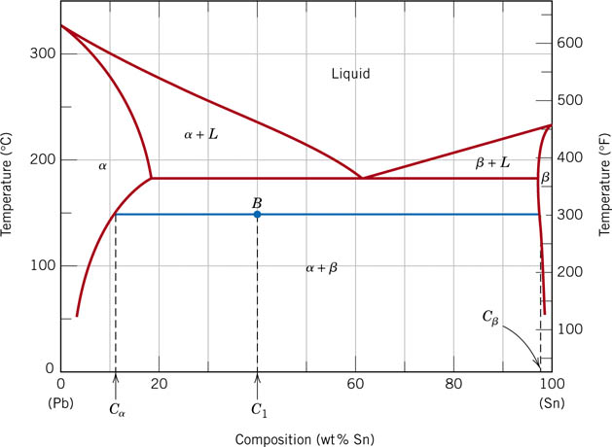
EX. 9.2
For a 40 wt% Sn-60wt% Pb alloy at 150˚C,
What phase(s) is (are) present?
What is (are) the composition(s) of the phase(s)?

Slide 57
EX. 9.3
For the lead-tin alloy in Example Problem 9.2, calculate the relative amount of each phase present in terms of (a) mass fraction and (b) volume fraction. At 150˚C take the densities of Pb and Sn to be 11.23 and 7.24 g/cm³, respectively.

Slide 58
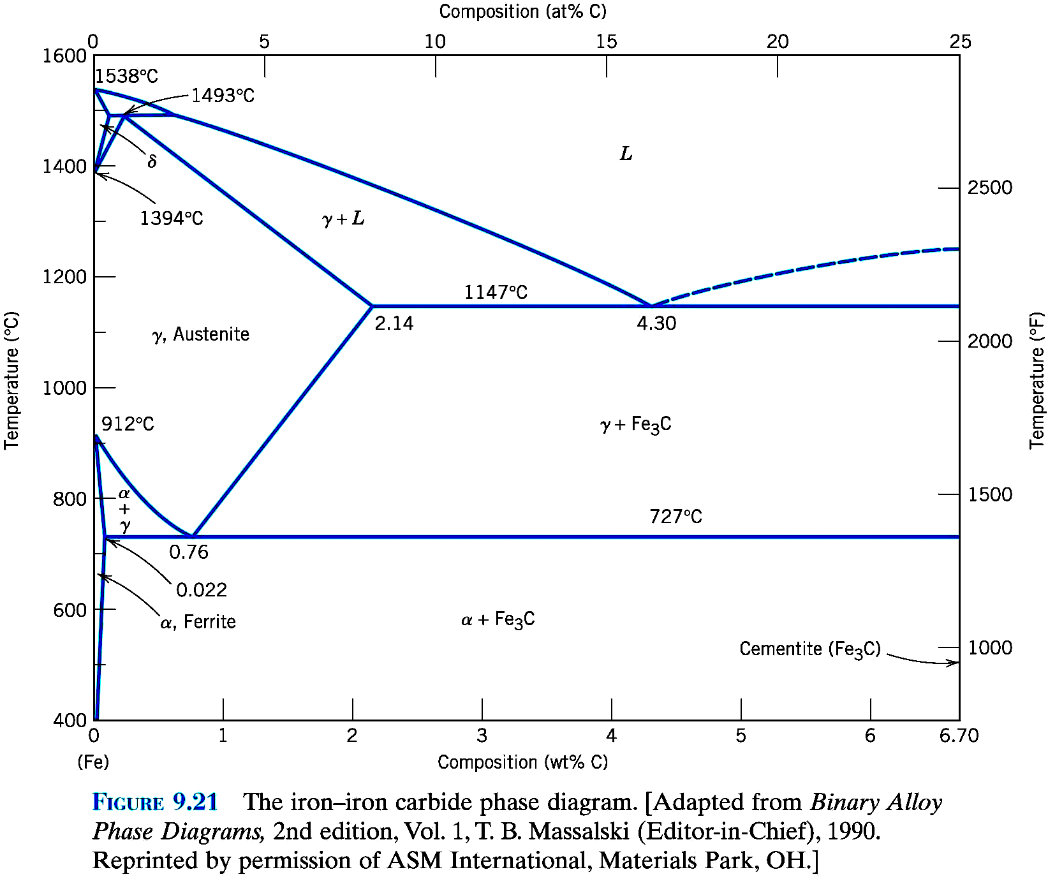
For a 99.65 wt% Fe -0.35wt% C alloy at a temperature just below the eutectoid, determine the following:
  The fractions of total ferrite and cementite phases
  The fractions of the proeutectoid ferrite and pearlite
  The fraction of eutectoid ferrite

